Slide 1
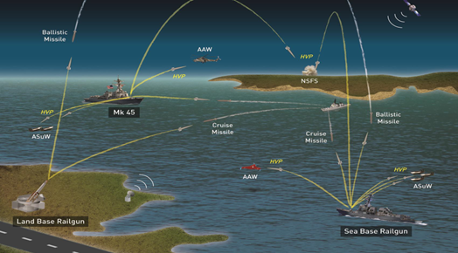
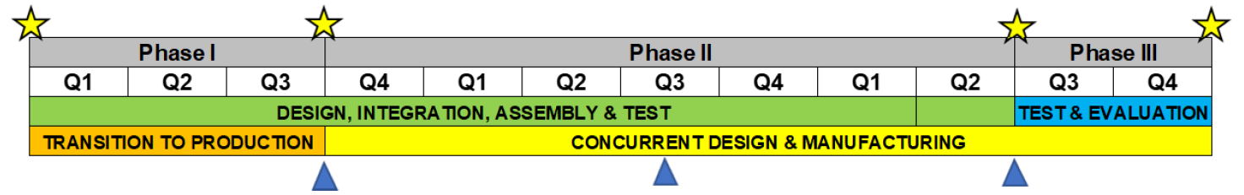
LAND-BASED ELECTROMAGNETIC RAILGUN (LB-EMRG)
  (U) Technology Description / Product
LB-EMRG fires the Hypervelocity Projectile (HVP) to Mach 7+ and 100 NM
Accomplished 456 test flights and 23 successful intercepts
Accomplished 20 rounds per min
Hypervelocity Gun Weapon System (HGWS) is significantly outperformed by EMRG in flight tests
  Mach 4+ / range: 17-41 nm (depending on gun)
Starting TRL: 7 Ending TRL: 9
  (U) Expected Operational Value
Greater maneuverability at greater ranges than other HVP systems
Greater command agility allowing variation in defensive system selection
Allows greater performance symmetry of defensive missile systems
Capable of massing fires on threats from multiple locations
Lead Blocker, Integrated Air and Missile Defense of Guam
(U) Key Partners / Participants
Project Lead (PL) Agency: Missile Defense Agency
Gov’t Contributors: USINDOPACOM
Transition Partners: USINDOPACOM, RCCTO, U.S. Army Futures Command
Other Partners: GA-EMS, BAE, NSWC Dahlgren, TBE, APL, LLNL, more forthcoming
  (U) Transition Strategy
  MDA matures TRL to transition path for multiple stakeholders
  USAF to enhance the GLADIATR program for enhanced based defense
  U.S. Army: IAMD, Shoreline Defense, CUAS (types 1-3), Sub/Supersonic cruise missile defense, Large caliber rocket defense
(U) Funding
(U) Key Deliverables
  Upgraded System (from NSF Dahlgren)
  System integration with IBCS and IFCN
  Operational Prototype
  Capability Delivery
  Capable of massing fires on threats from multiple locations
  32MJ LB-EMRG w/initial capability of 20 rounds/min
  Enhanced demonstration to validate CONOPS for new deterrent system
  AUKUS/Japan/ROK opportunity to co-develop tactical system, cross-AOR supply chain; Quad-Lateral effort to mitigate contested logistics threat by extreme depth of newly layered defense
Cost Share-Cash ($K) | FY25 | FY26 | FY27 | Total
OSD / RPP Funds | $13M | $16M | $21M | $50M
USINDOPACOM | TBD | TBD | TBD | TBD
TOTAL | $13M | $16M | $21M | $50M
  (U) Milestones Leading to MUA and Fielded Capability
Year 1: $13M Phase I design, integration, test and production
Year 2: $16M Phase 2 design, integration, test and mfg.
Year 3: $21M Phase 3 test, evaluation and transition
  Proposal POC: Mr. Jason Dupuis, DRAPER, jdupuis@draper.com
  Proposal POC: Dr. Mock Abdelaal, DRAPER, mabdelaal@draper.com
Revision Date: 13/06/2024

